Slide 1
Fairview Elementary
Extraordinary 1st Grade Team

Slide 2
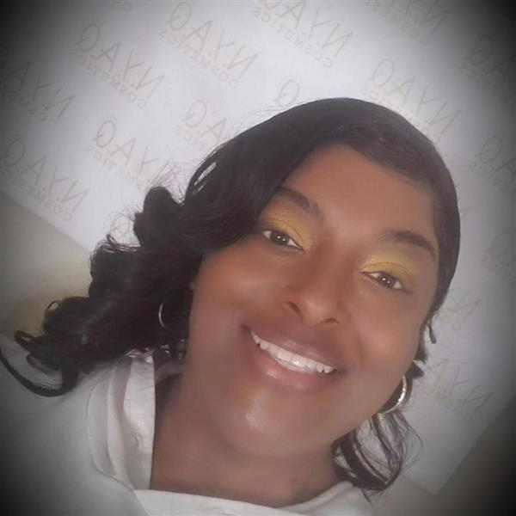
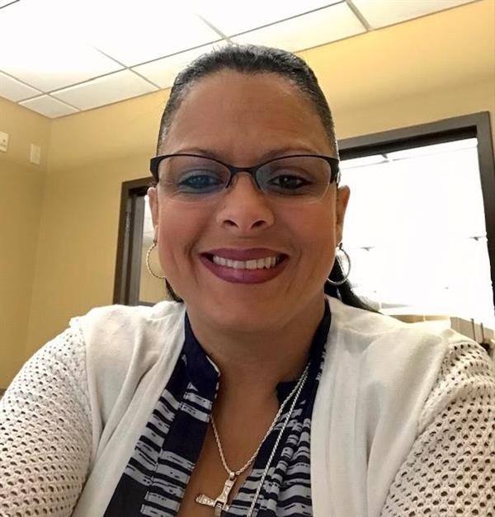
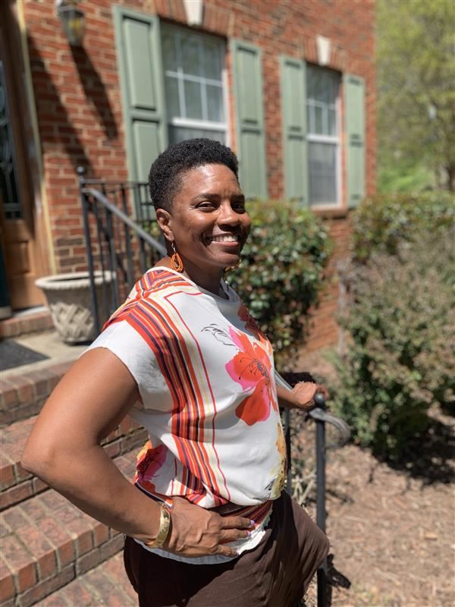
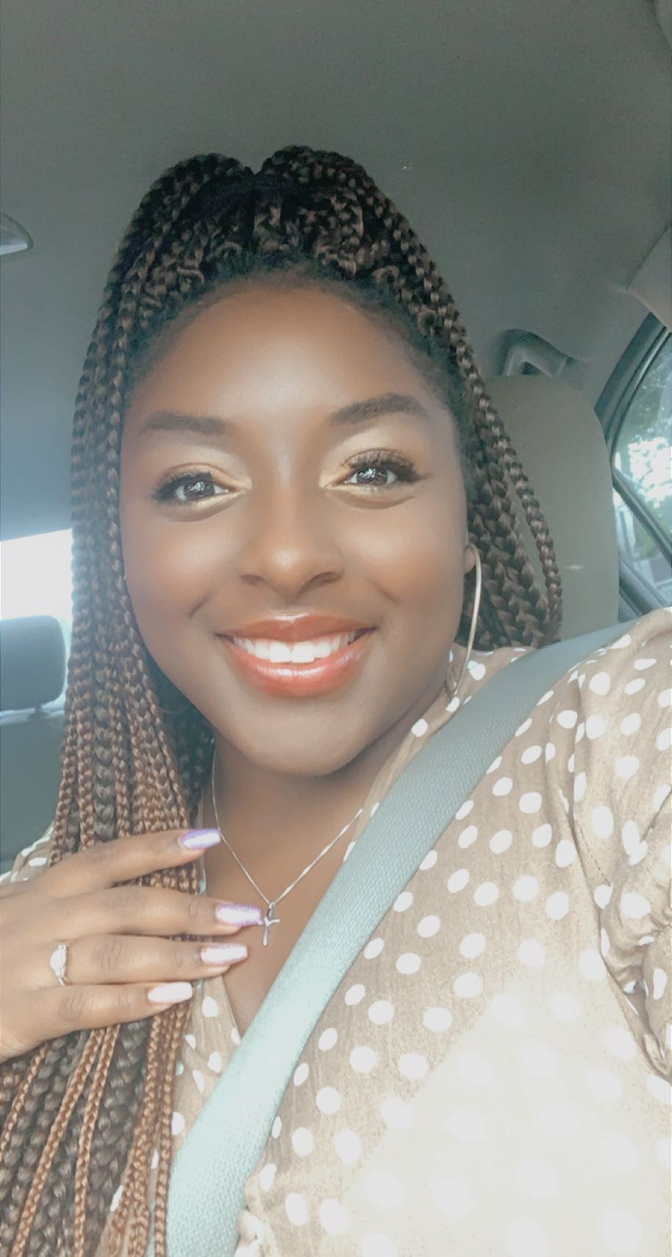
Meet the 1st Grade Team
Ms. Allen
Mrs. Schley
Mrs. Stroud
Mrs. Cushman

Slide 3
How to seek assistance
Teacher emails
Ms. Allen-------- eallen1@henry.k12.ga.us
Ms. Cushman------ dezha.Cushman@henry.k12.ga.us
Mrs. Schley------- kimberly.schley@henry.k12.ga.us
Mrs. Stroud------- trina.stroud@henry.k12.ga.us
Teachers may also other modes of communication if assistance is needed.

Slide 4
1st Grade Daily Schedule
7:45-8:30 Math 2 Reteach | 8:30-9:15 Social Studies/ Science | 9:15-9:30 Reading Activity/ Wordly Wise | 9:30-10:30 ELA 1 New Skills Open Court | 10:30-11:15 ELA 2 Reteach Writing | 11:15-11:40 Lunch | 12:00-12:45 Specials | 1:00-2:00 Math 1 New Skills
Never Stop Learning!

Slide 5
Expectations
Students are expected to be present and on time for school daily.
Students are expected to be prepared for daily for class.
Students are expected to respect themselves and others.
Students are expected to put forth their best effort.
Students are expected to follow classroom rules and procedures.
Students are expected to take responsibility for their learning and their actions.
Students are expected to be positive at all times.

Slide 6
Classwork and Homework
Classwork
Classwork assignments are given throughout the day during school day instructional hours.
Students are expected to complete all assignments during this time. Students who need and require extended time are provided an opportunity to complete assignments. Students who require additional help on assignments are helped individually by the teacher or the para.
Homework
Homework is assigned at the discretion of the teacher. Homework may or may not be given daily. However, students are expected to return all assigned homework as requested by the teacher. Grades are given for homework, so it is imperative to complete all homework assignments.

Slide 7
Monday Folders
Monday folders are sent home every Monday. If your students does not bring home a Monday folder please reach out to the teacher. Monday folders normally include any written communications from the school or the teacher. The folder should also include some graded work. Ticking for Fluency is also normally in the folder. Please take a few minutes to complete the ticking for fluency nightly with your student. We are trying to build sight word recognition, vocabulary, fluency, and comprehension in reading with each student.

Slide 8
Parent Resource Center
At Fairview Elementary School, you are encouraged to become an active participant in your child’s education. We invite you to visit our Family Resource Center, room 402, to have access to materials to help support your child’s academic success. From leveled read along books to learning games, we feel certain that you will find something useful for working with your child at home. The Family Resource Center is opened on school days from 8:00 – 2:00 pm. If you are unable to visit during these hours, please contact Ms. Campbell for an alternate appointment.

Slide 9
Curriculum/ELA
English, Language Arts, and Reading
Story Elements: Characters, Settings, Major Events, Key Details
Writing: Opinion, Informative, and Narrative Writings
Compare and Contrast
Punctuation, Capitalization, Sentence Structure, Syllables, Sounds, Phonics

Slide 10
Curriculum/Math
Understanding Data in Math: Chart Reading
Counting by 1’s 5’s and 10’s
Word problems within 20
Counting and Identifying Numbers up to 120
Addition/Subtraction: Adding/Subtracting within 20, Solving for the Unknown
Time
Length & Measurement
Place Value: Ones and Tens
Understanding Shapes & Fractions

Slide 11
Weather Magnets Light and Sound Plants and Animals
Curriculum/Science

Slide 12
Curriculum/Social Studies
Using Maps & Globes
Features of the Earth Surface
Historical Figures
Patriotism
Producers, Consumers, Goods, and Services

Slide 13
Teacher Webpages
Teacher webpages can be found on the Fairview Elementary Webpage under the Faculty and Staff tab. Webpages may be updated throughout the year.

Slide 14
Mini Lesson
Writing a narratives:
ELAGSE1W3: Write narratives in which they
Recount two or more appropriately sequenced events, include
Some details regarding what happened, using transitional words
To signal event order and provide some sense of closure.

Slide 15
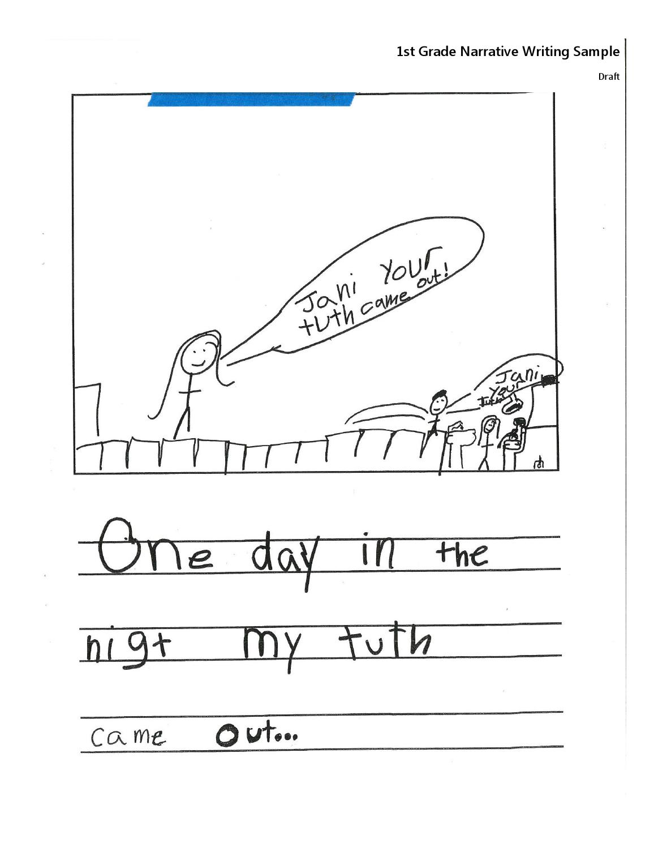
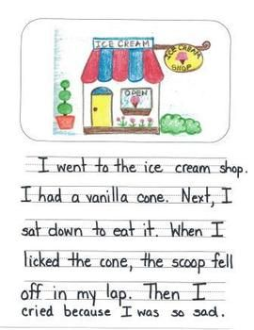
What 1st grade writing should look like and not look like
What we should see
What we are seeing

Slide 16
What students should know by now
ELA/Grammar
Write your first and last name, write on the line, Decode words, formulate complete sentences using correct capitalization and punctuation, read on grade level, retell and extract key details from a written text.
Math
Count to 120, count by 1’s and 10’s, interpret data, place value, and adding and subtraction within 20

Slide 17
Where parents can find the standards
Want to know what your student will learn during the school year? You can locate the curriculum standards for your student on Henry County Schools Webpage. Click the Parent link and click Learning in Henry and in the drop down menu click Academics.

